Slide 1
Virtual Memory Management Chapter 9

Slide 2
Background
Memory management is important
Instructions being executed must be in the physical memory.
The entire program may not need to be in memory for execution
Error handling routines
Over allocated arrays and data structures
Certain features may be used rarely (e.g. fee module)
Benefits of executing a program that is partially in memory
More programs running concurrently
No constrain on the amount of physical memory
Less I/O needed to load or swap processes

Slide 3
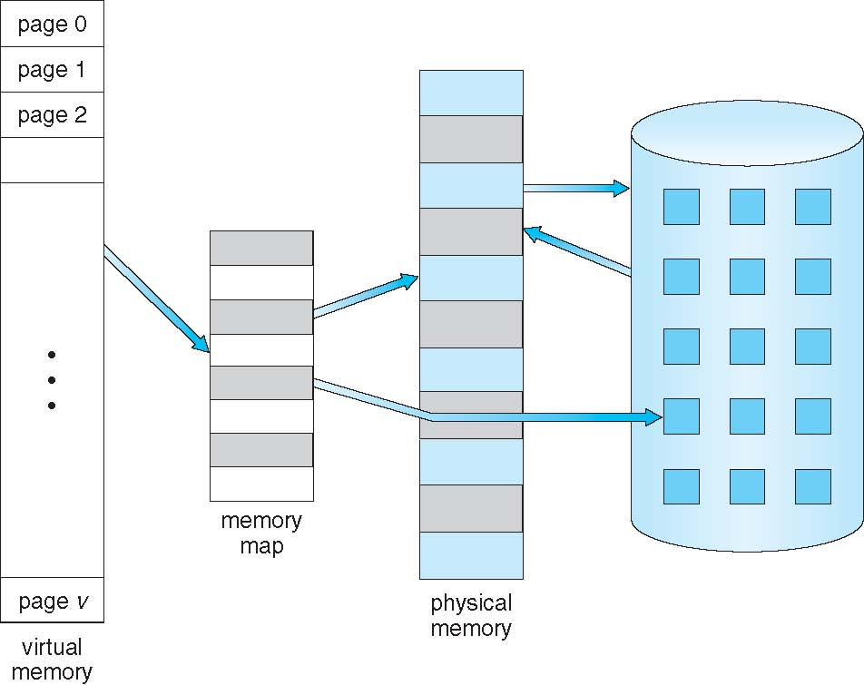
Background
Virtual memory –separation of logical memory from physical memory
Logical address space can therefore be much larger than physical address space
Programmer no longer needs to worry about the amount of physical memory available or overlays
Allows address spaces to be shared by several processes
Allows for more efficient process creation

Slide 4
Background
Virtual address space – logical view of how process is stored in memory
Usually start at address 0, contiguous addresses until end of space
Meanwhile, physical memory organized in frames
MMU must map logical to physical
Virtual memory can be implemented via:
Demand paging

Slide 5
Demand Paging
Could bring entire process into memory at load time
Or bring a page into memory only when it is needed
Less I/O needed, no unnecessary I/O
Less memory needed
Faster response
More users
Similar to paging system with swapping (figure on the next slide)
Page is needed ⇒ reference to it
invalid reference ⇒ abort
not-in-memory ⇒ (page fault) bring to memory
Lazy swapper – never swaps a page into memory unless page will be needed
Swapper that deals with pages is a pager

Slide 6
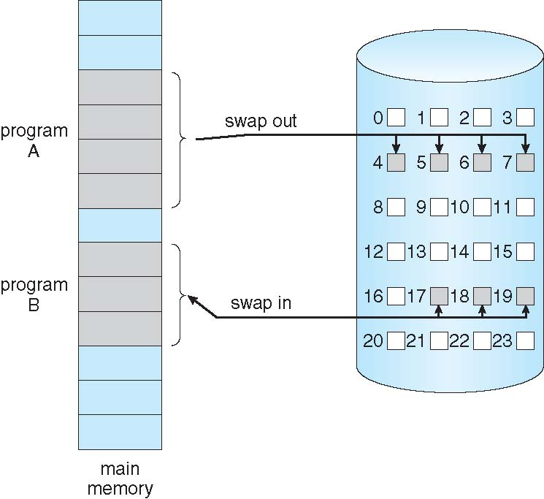
Demand Paging

Slide 7
Basic Working
With swapping, pager guesses which pages will be used
Pager brings in only those pages into memory
Hardware support needed for demand paging
Page table with valid / invalid bit
Secondary memory (swap device with swap space)
Instruction restart
If pages needed are already memory resident
No difference from non demand-paging
If page needed is not memory resident
Need to detect and load the page into memory from storage
Without changing program behavior
Without programmer needing to change code

Slide 8
Valid-Invalid Bit
With each page table entry a valid–invalid bit is associated (v ⇒ in-memory – memory resident, i ⇒ not-in-memory)
Initially valid–invalid bit is set to i on all entries
Example of a page table snapshot:
During MMU address translation, if valid–invalid bit in page table entry
is i ⇒ page fault
Frame #
valid-invalid bit
v
v
v
v
i
….
i
i
page table

Slide 9
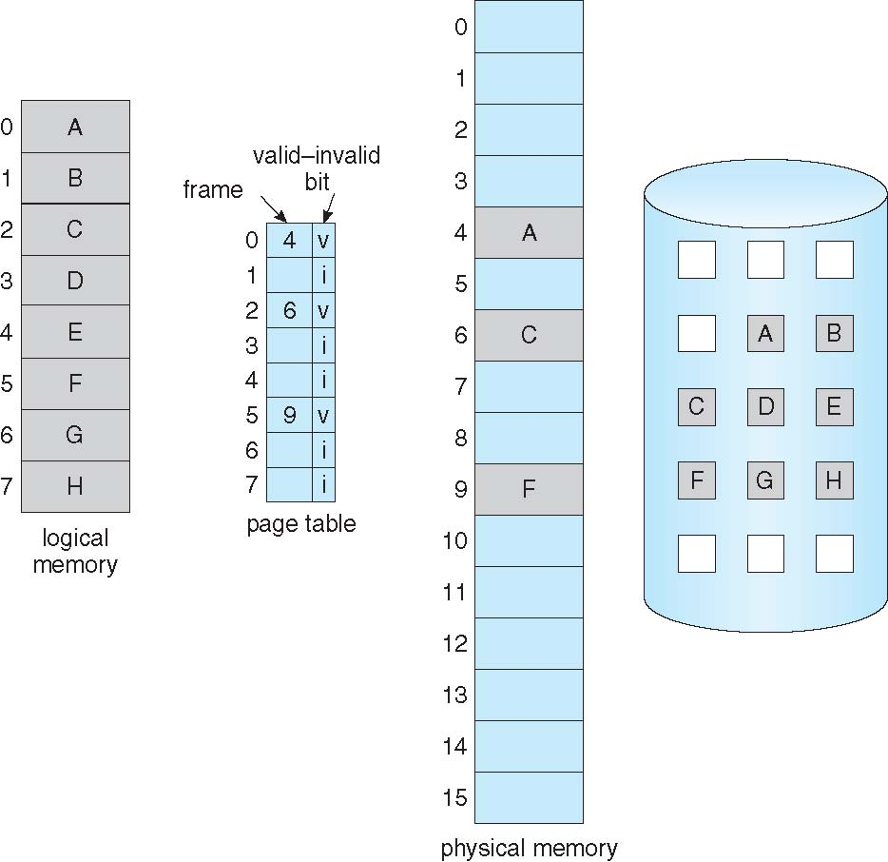
Page Table When Some Pages Are Not in Main Memory

Slide 10
Page Fault
If there is a reference to a page, first reference to that page will trap to operating system:
page fault
Operating system looks at another table to decide:
Invalid reference ⇒ abort the process
Just not in memory
page it in
Find free frame
Swap page into frame via scheduled disk operation
Reset tables to indicate page now in memory Set validation bit = v
Restart the instruction that caused the page fault

Slide 11
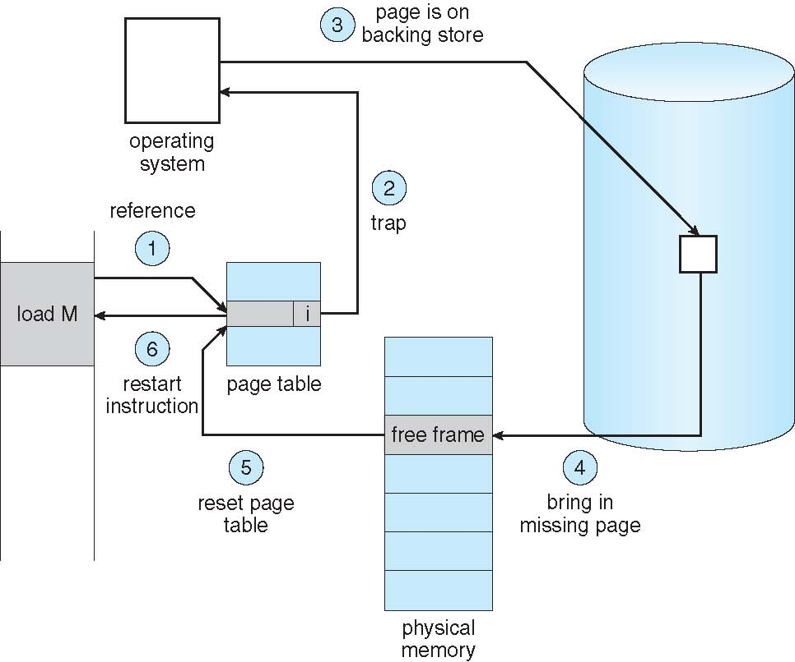
Steps in Handling a Page Fault

Slide 12
Pure Demand Paging
Pure demand paging : Never bring a page into memory until it is required.
Extreme case – Start process with no pages in memory
OS sets instruction pointer to first instruction of process, which is on a non-memory-resident
Page fault
Page is brought into the memory
Process continue to execute, faulting as necessary until every page that it needs is in memory
At this point, it can execute with no more faults.
Theoretically, some program could access several new pages of memory with each instruction execution (one page for instruction and many for data) -> Possibly causing multiple page faults per instruction.
This Situation would result in unacceptable system performance
Consider fetch and decode of instruction which adds 2 numbers from memory and stores result back to memory

Slide 13
Cont…
Major difficulty occurs when an instruction may modify several different locations
For example, consider IBM system 360/370 MVC (move character) instruction, which
Can move up to 256 bytes from one location to another (possibly overlapping) location
If either block (source or destination) span a page boundary
Page fault might occur after move is partially done
In addition, if the source or destination blocks
overlaps, the source block may have been modified
In this case we cannot simply restart the instruction
The problem can be solved in two different ways.
The microcode computes and attempt to access both ends of both blocks. If page fault is going to occur. It will be identified at this step before anything is modified.
Use the temporary registers to hold the values of overwritten locations
If page fault, all the old values are written back into the memory before the trap occur.
Restore the memory to its state before instruction was started so that the instruction can be repeated.

Slide 14
Performance of Demand Paging
Demand paging can significantly affect on the performance of a computer system.
How ??
let's us compute the effective access time for a demand paged memory
Stages in Demand Paging (worse case)
Trap to the operating system
Save the user registers and process state
Determine that the interrupt was a page fault
Check that the page reference was legal and determine the location of the page on the disk
Issue a read from the disk to a free frame:
Wait in a queue for this device until the read request is serviced
Wait for the device seek and/or latency time
Begin the transfer of the page to a free frame

Slide 15
Cont…
While waiting, allocate the CPU to some other user (CPU scheduling optional)
Receive an interrupt from the disk (I/O completed)
Save the registers and process state for the other user (if step 6 is executed)
Determine that the interrupt was from the disk
Correct the page table and other tables to show that the desired page is now in memory
Wait for the CPU to be allocated to this process again
Restore the user registers, process state, and new page table, and then resume the interrupted instruction

Slide 16
Cont…
Not all the previously discussed steps are necessary in every case i.e., step 6
Therefore, in any case three major components of page fault are faced
Service the page fault interrupt
Read in the page
Restart the process
The first and third tasks may be reduced with careful coding
These tasks may take from 1- 100 microseconds each
The page-switch time will probably be close to 24 milliseconds
Page Fault Rate 0 ≤ p ≤ 1
if p = 0 no page faults
if p = 1, every reference is a fault
Effective Access Time (EAT)
EAT = (1 – p) x memory access + p x page fault service time
= (1 – p) x 100+ p x (25 milliseconds)
=(1 – p) x 100+ p x 25,000,000
=100+ 24,999,900x p

Slide 17
What Happens if There is no Free Frame?
Page replacement – find that there are no free frame on the free-frame list; all memory is in use (fig. 9.9 on next slide)
The OS has several options at this point:
Terminate the user process
Demand paging is OS attempt to improve the throughput and performance
Paging should be logically transparent from user
Users should not be aware that their processes are running on a paged system therefore, this option is not the best choice
swap out
Freeing all its frames and reducing the level of multiprogramming. This option is good in certain circumstances
Page replacement: Our focus in this section

Slide 18
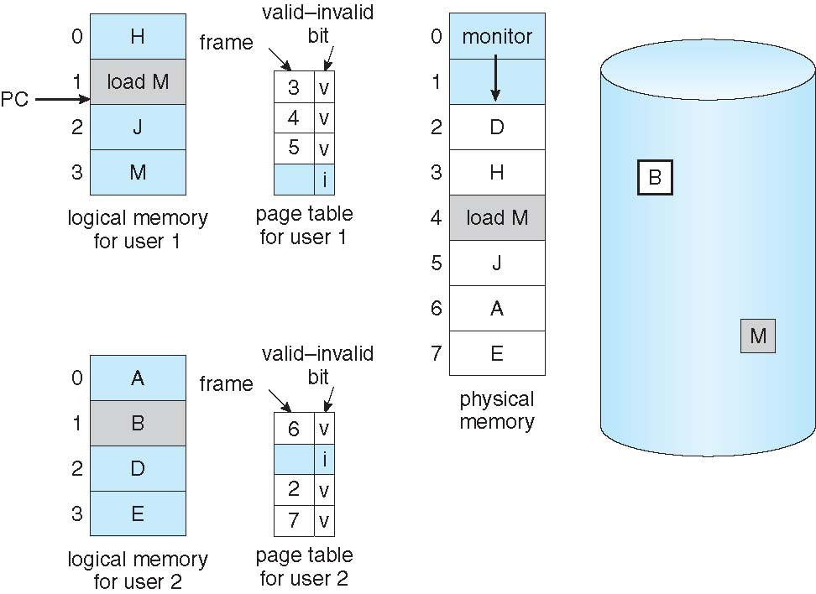
Need For Page Replacement
Fig. 9.9. Need for page replacement

Slide 19
Basic Page Replacement
1 ) Find the location of the desired page on disk
2 ) Find a free frame: a) If there is a free frame, use it b) If there is no free frame, use a page replacement algorithm to
select a victim frame
c) Write the victim frame to the disk; change the page and frame
tables accordingly
3) Bring the desired page into the (newly) free frame; update the page and
frame tables
4) Continue the process by restarting the instruction that caused the trap
Note: Now there are two page-transfers for a page fault – increasing EAT

Slide 20
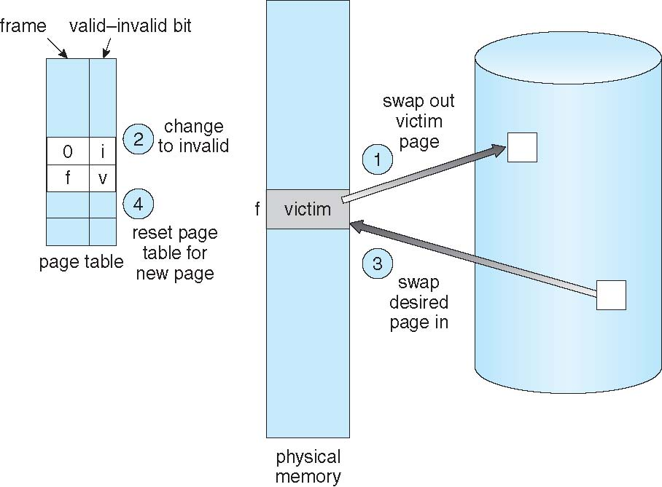
Page Replacement
Fig. 9.10. Page replacement

Slide 21
Page Replacement Algorithms
Want lowest page-fault rate on both first access and re-access
Evaluate algorithm by running it on a particular string of memory references (reference string) and computing the number of page faults on that string
String is just page numbers, not full addresses
Repeated access to the same page does not cause a page fault
Results depend on number of frames available
In all our further examples, the reference string will be as follow :
7,0,1,2,0,3,0,4,2,3,0,3,0,3,2,1,2,0,1,7,0,1

Slide 22
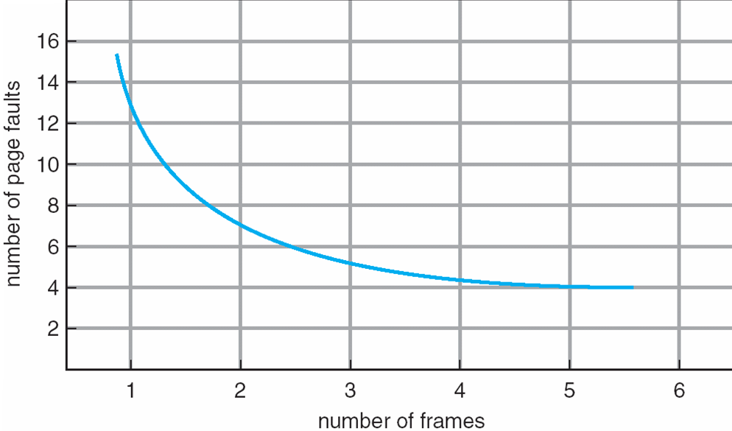
Graph of Page Faults Vs The Number of Frames
Fig. 9.11. Graph of page fault versus number of frames

Slide 23
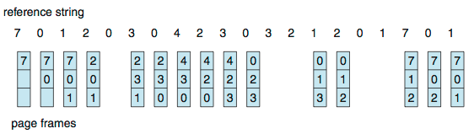
First-In-First-Out (FIFO) Algorithm
Reference string: 7,0,1,2,0,3,0,4,2,3,0,3,0,3,2,1,2,0,1,7,0,1
3 frames (3 pages can be in memory at a time per process)
Can vary by reference string: consider 1,2,3,4,1,2,5,1,2,3,4,5
How to track ages of pages?
Just use a FIFO queue
15 page faults
Fig. 9.12. FIFO page-replacement algorithm

Slide 24
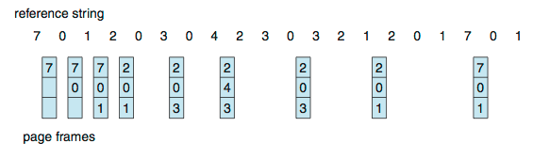
Optimal Algorithm
Reference string: 7,0,1,2,0,3,0,4,2,3,0,3,0,3,2,1,2,0,1,7,0,1
Replace page that will not be used for longest period of time
Read the future string
9 is optimal for the example
Fig. 9.14. Optimal page-replacement algorithm

Slide 25
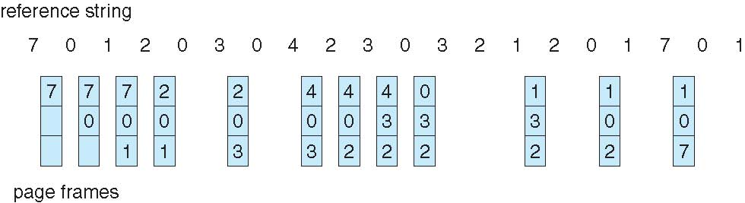
Least Recently Used (LRU) Algorithm
Reference string: 7,0,1,2,0,3,0,4,2,3,0,3,0,3,2,1,2,0,1,7,0,1
Use past knowledge rather than future
Replace page that has not been used in the most amount of time
Associate time of last use with each page
12 faults – better than FIFO but worse than OPT
Generally good algorithm and frequently used
But how to implement?
Counters : time-of-use
Stack
Fig. 9.15. LRU page-replacement algorithm

Slide 26
FIFO Illustrating Belady’s Anomaly

Slide 27
Thrashing
If a process does not have “enough” pages, the page-fault rate is very high
Page fault to get page
Replace existing frame
But quickly need replaced frame back
This leads to:
Low CPU utilization
Operating system thinking that it needs to increase the degree of multiprogramming
Another process added to the system
This high paging activity is called Thrashing ≡ A process is busy swapping pages in and out
A process is thrashing if it is spending more time paging than executing.

Slide 28
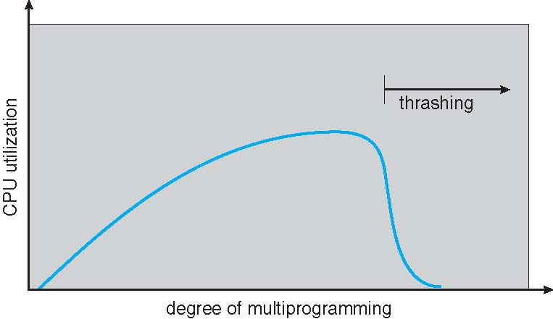
Thrashing (Cont.)

Slide 29
Locality Model
To prevent thrashing, we must provide a process as many frames as it needs. But how do we know how many frames it "needs"? There are several techniques.
The working-set strategy starts by looking at how many frames a process is actually using. This approach defines the locality model of process execution.
The locality model states that, as a process executes, it moves from locality to locality.
A locality is a set of pages that are actively used together. A program is generally composed of several different localities, which may overlap.

Slide 30
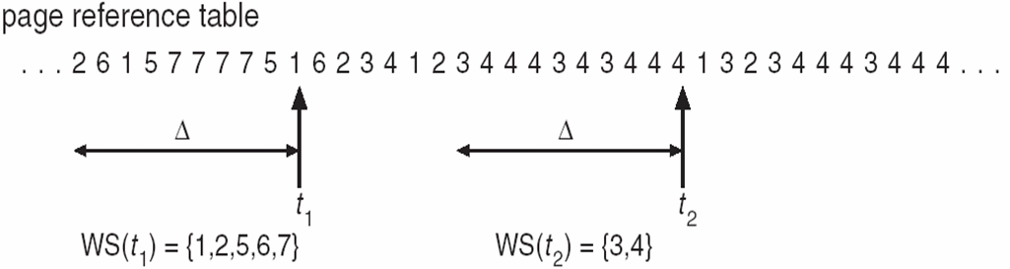
Working-Set Model
The working-set model is based on the assumption of locality.
This model uses a parameter, Δ, to define the working-set window. For example Δ≡ working-set window ≡ a fixed number of page references
The idea is to examine the most recent Δ page references. The set of pages in the most recent Δ page references is the working set (Figure 9.20).
If a page is in active use, it will be in the working set. If it is no longer being used, it will drop from the working set Δ time units after its last reference. Thus, the working set is an approximation of the program's locality.
Fig. 9.20. Working-set model for Δ =10

Slide 31
Working-Set Model (Cont)
The accuracy of the working set depends on the selection of Δ.
If Δ is too small it will not encompass entire locality
If Δ is too large it will encompass several localities
If Δ= ∞⇒ it will encompass entire program
The most important properties of working set than is its size.
WSSi (working set size of Process Pi) = total number of pages referenced in the most recent Δ(varies in time)
D= ΣWSSi ≡ total demand frames
If D > m (total number of available frames)⇒Thrashing will occur
Because some processes will not have enough frames
Suspend one of the processes

Slide 32
Other considerations --Prepaging
The selection of page replacement algorithm and allocation policy are the major decisions that we make for a paging system. There are many other considerations as well.
Prepaging
To reduce the large number of page faults that occurs at process startup
Prepage all or some of the pages a process will need, before they are referenced
But if prepaged pages are unused, I/O and memory was wasted
Assume s pages are prepaged and a fraction α of the pages is used
Is cost of s * α save pages faults greater or less than the cost of prepaging s * (1-α) unnecessary pages.
If α is close to 0 ⇒prepaging loses
If α is close to 1 ⇒prepaging wins

Slide 33
Other Issues –Page Size
Page size selection must take into consideration:
Fragmentation
The bigger the page size the more internal fragmentation it will have. On average each segment will have half a page of internal fragmentation. So if we have a page of 2K then 1K will be wasted in each segment. This means that from fragmentation point of view smaller page is better.
Table size
Page table contains frame numbers for each page. If there are more pages then there will be more entries meaning page table will be big. If we increase page size then there will be lesser entries in the page table resulting in smaller page table. A smaller page table will require less memory. So from page table point of view bigger page size is desirable.

Slide 34
Cont…
I/O overhead
In I/O operation to hard disk the biggest penalty is the seek time. Once the correct sector is reached then reading or writing data is not that time consuming. Reading or writing 2K fractionally consumes more time than 1K. This means that from an I/O overhead bigger page size is better.
Locality
Locality is the set of logical addresses that a process generates in some delta time. It changes as the process continues its execution. Smaller page size can give a fine grain control over the locality by bringing into RAM only those areas of address space that are needed. A bigger page will bring in more than what is needed resulting in wasted space. So from locality consideration a smaller page is better.

